Slide 1
MEDIA
Ivan Ivanov
Tsvetelina Stoyanova

Slide 2
INTRODUCTION
We created the web application Media, that allows users to share, rate and comment virtual content.

Slide 3
MAIN FUNCTIONALITIES – OVERVIEW:
Sign-in / Sign-up to publish content
Read, rate, comment and publish articles
Share photos
Vote in polls
Track upcoming events
Search for your favourite content

Slide 4
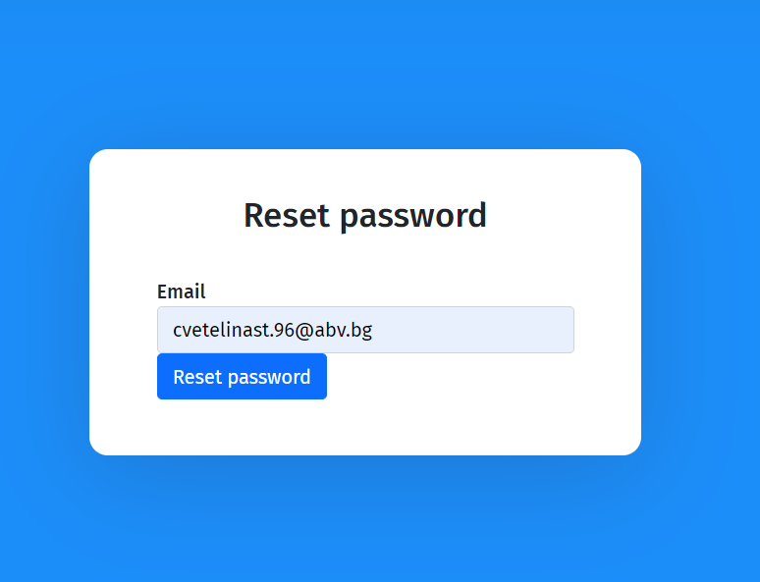
Sign-in / Sign-up
Reset password
Token expiration and logout
Password strength check
Register and login validation

Slide 5
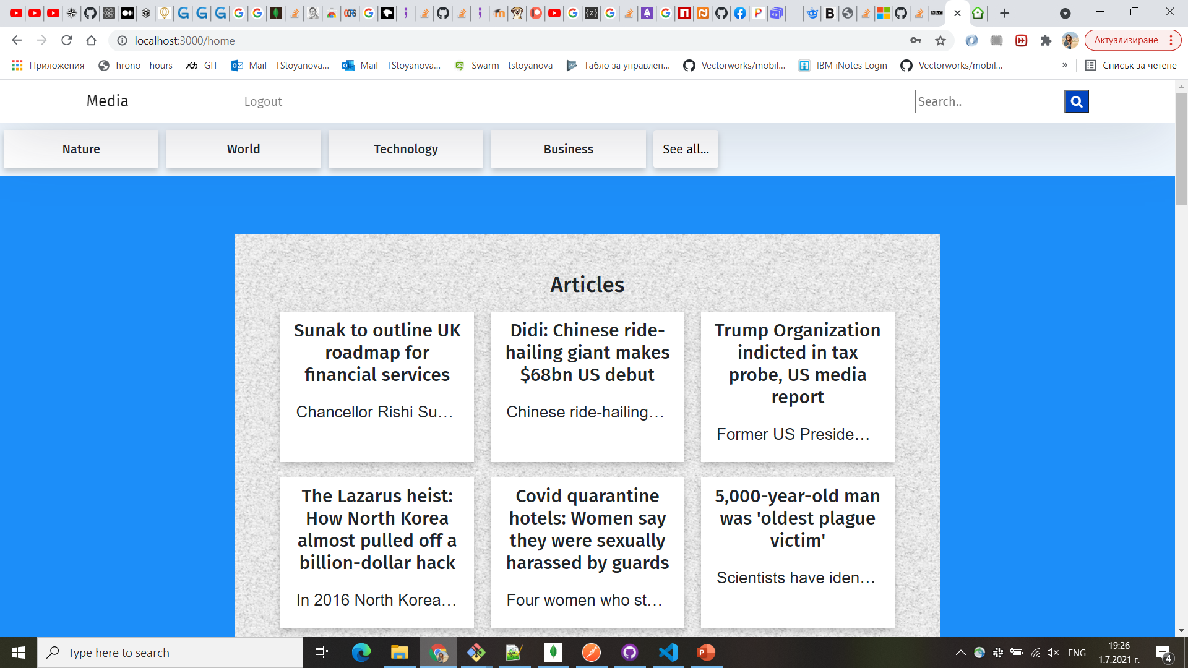
Home page
Provides the latest articles, photos, polls and events information
Not logged-in user can see content

Slide 6
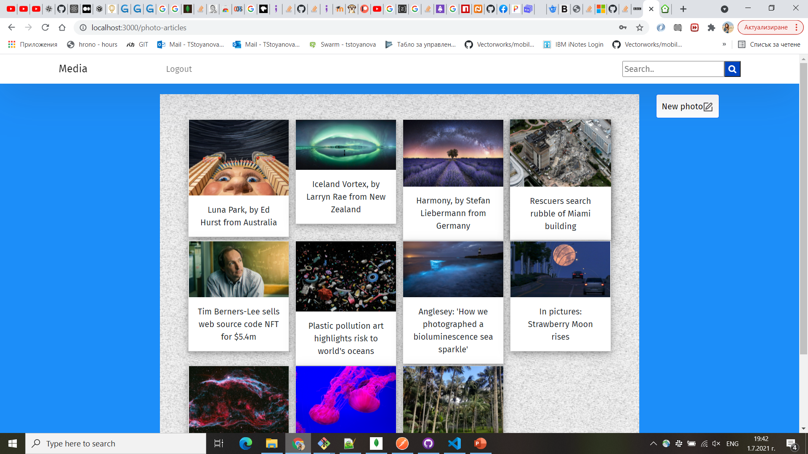
ARTICLES AND PHOTO GALLERY
Infinite scroll lists
Read and search for not logged-in users
Publish, Comment and Rate for logged-in users
Date time stored and visualized

Slide 7
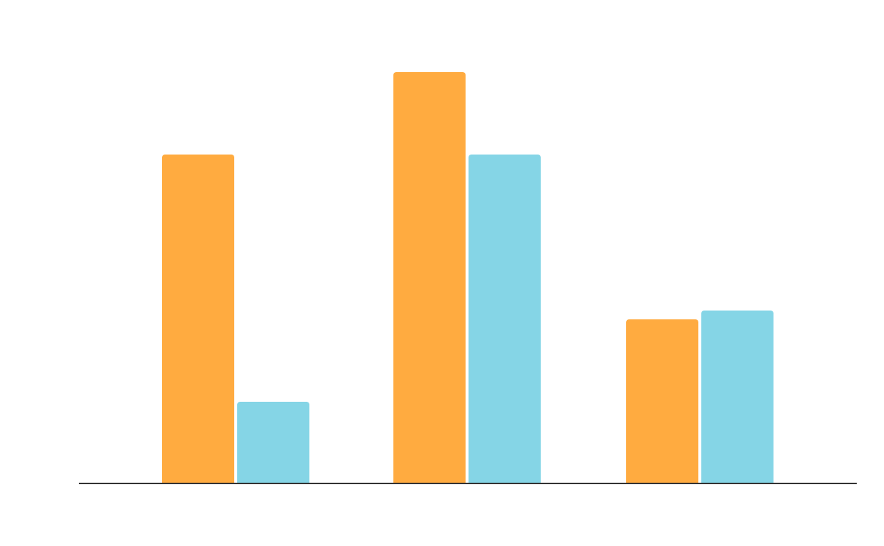
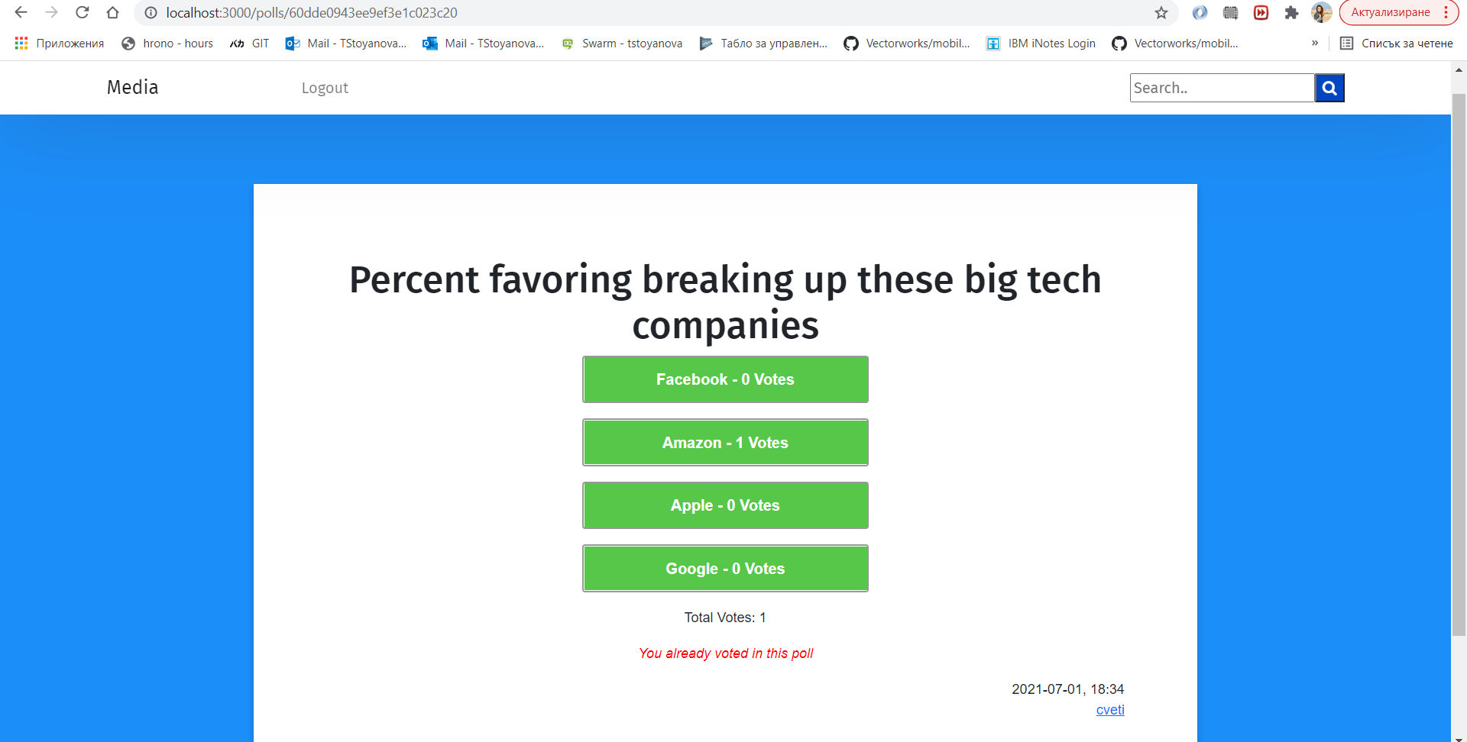
POLLS
Free count of possible answers
Total votes available
Not possible to vote twice
Does not reveal the results until you vote
A not logged-in user cannot vote or see the results

Slide 8
01
02
03
BY AUTHOR
BY TOPIC
BY PHRASE
SEARCH FOR YOUR FAVOURITE CONTENT:
Click on an author
Click on a topic from the topic list of from an existing article/photo
Enter a word or a phrase in the search bar

Slide 9
USED TECHNOLOGIES
REACT.JS
NODE.JS
JAVASCRIPT
MONGODB
MONGOOSE
JWT TOKENS

